Slide 1
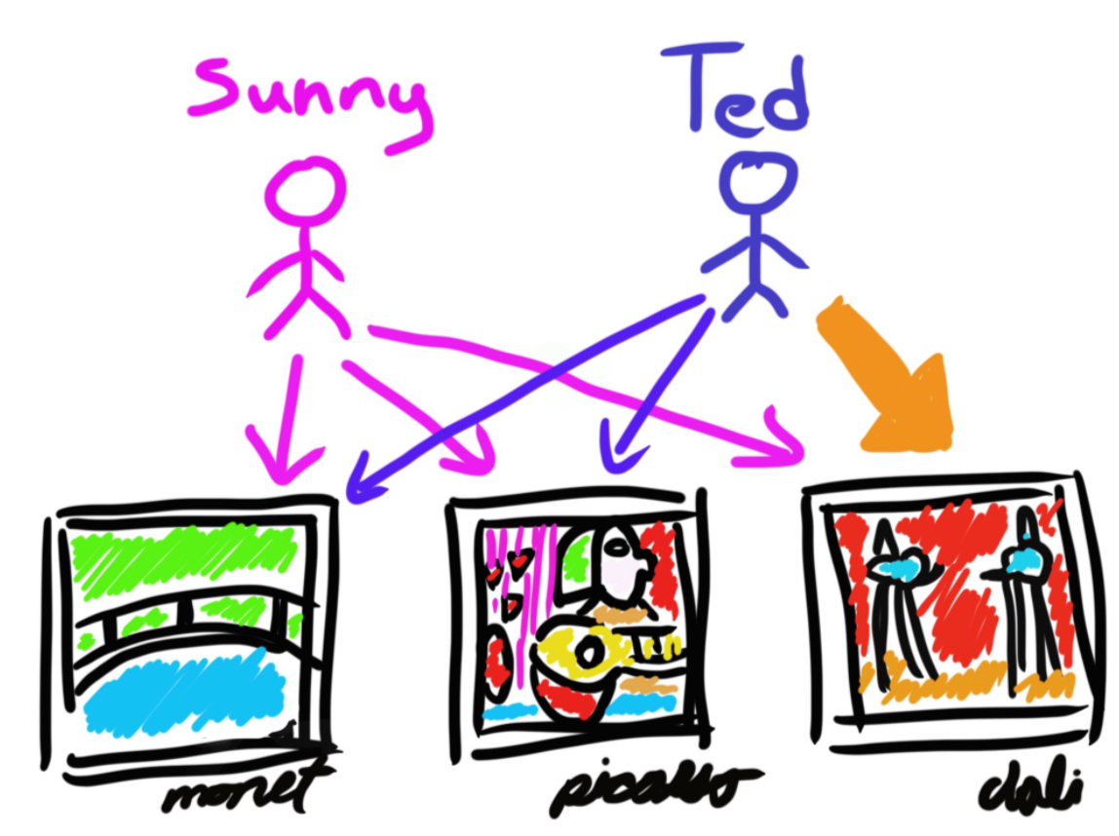
An introduction into recommender systems.
Kris Manohar

Slide 2
Motivation and overview
Recommender systems are everywhere!
Google search
Amazon
App stores
Personalizes the link between few users and many items
Recommendations are made by mapping users and item into a common space
Main classes of recommend systems
Knowledge based
Content based
Collaborative filtering
Deep neural networks

Slide 3
Content based recommender systems
Uses item features to recommend new items to users
Maps the user into the item feature space
Inferences are made from items in a user’s history (explicit / implicit)
Does not require other user-item interactions
Good for niche items
Bad for discovering a user’s interest
Requires domain knowledge to determine the items features

Slide 4
Content based recommender systems
Which movie is similar to how to train your dragon?
 | Fantasy | Action | Cartoon | Drama | Comedy
How to train your dragon
Fury
Jumanji
Love and monsters
The lord of the rings
The Mitchells vs the Machines
Joker

Slide 5
Content based recommender systems
Each item, is k-hot encoded
 | Fantasy | Action | Cartoon | Drama | Comedy
How to train your dragon |  |  | 1 |  | 1
Fury |  |  |  | 1
Jumanji | 1 |  |  |  | 1
Love and monsters | 1 | 1 |  |  | 1
The lord of the rings | 1 | 1 |  | 1
The Mitchells vs the Machines |  | 1 | 1 |  | 1
Joker |  |  |  | 1

Slide 6
Content based recommender systems
User feature vector (maps user into the item feature space)
Scale feature vectors based on the users rating
Normalize the resulting vector
What about action? No rating, no inference
User |  | Fantasy | Action | Cartoon | Drama | Comedy
6 | × |  |  | 1 |  | 1
3 | × |  |  |  | 1
10 | × | 1 |  |  |  | 1
Summed | = | 10 | 0 | 6 | 3 | 16
Normalized | = | 0.286 | 0 | 0.171 | 0.086 | 0.457

Slide 7
Content based recommender systems
Dot product of user feature vector with remaining items gives a measure of similarity.
 | Fantasy | Action | Cartoon | Drama | Comedy | Similarity
How to train your dragon (6) | 0 | 0 | 0.171 | 0 | 0.457 | 0.629
Fury (3) | 0 | 0 | 0 | 0.086 | 0 | 0.086
Jumanji (10) | 0.286 | 0 | 0 | 0 | 0.457 | 0.743
Love and monsters | 0.286 | 0 | 0 | 0 | 0.457 | 0.743
The lord of the rings | 0.286 | 0 | 0 | 0.086 | 0 | 0.371
The Mitchells vs the Machines | 0 | 0 | 0.171 | 0 | 0.457 | 0.629
Joker | 0 | 0 | 0 | 0.086 | 0 | 0.086

Slide 8
Collaborative filtering recommender systems
Learns form the user-item interaction matrix
Recommends without knowing anything the users and items
Learns laten factors based on the user interaction data
Exploits similarities between users and items simultaneously
Serendipity
Learns that user A interactions are a subset of user B interactions
Therefore its likely user A would like items that user B liked
The user-item interaction matrix which is usually sparse since not every user would have interacted with every item
Leverages explicit and implicit feedback to help fill the gaps - information is better than none!

Slide 9
Collaborative filtering recommender systems
Maps users and items in to a learnt, laten-feature space
Measures similarity between: users and users, item and items, users and items, and items and users, in common embedding space
Similarity measure: dot-product, Euclidian distance, etc.
 |  | LF1 | -0.689 | 0.412 | -0.768 | 0.346 | 0.912 | -0.999 | 0.152
 |  | LF2 | 0.939 | -0.989 | -0.397 | -0.889 | -0.978 | -0.803 | 0.604
LF1 | LF2 |  | M1 | M2 | M3 | M4 | M5 | M6 | M7
0.306 | -0.753 | U1 | × |  |  | × | ×
-0.238 | 0.150 | U2 |  | × |  |  |  |  | ×
-0.211 | -0.511 | U3 | × | × | × | ×
-0.430 | -0.895 | U4 |  |  | ? |  | × | ×

Slide 10
Collaborative filtering recommender systems
Uses factorization to reduce very large matrix in to two smaller matrices
Factorization extracts the general trends from the data across k dimensions
Less space k × (users + items) vs users × items
 | LF1 | … | LFk |  |  | LF1 | … | LFk |  |  | M1 | … | Mq
U1 |  |  |  |  | M1 |  |  |  |  | U1
⁞ |  |  |  |  | ⁞ |  |  |  |  | ⁞
⁞ |  |  |  |  | Mq |  |  |  |  | ⁞
Up |  |  |  |  |  |  |  |  |  | Up
U
×
V^{T}
A
͌

Slide 11
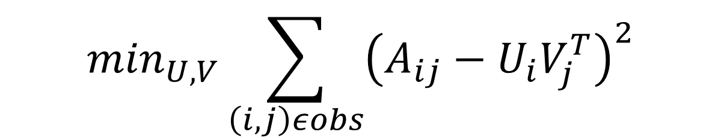
Collaborative filtering recommender systems
Matrix factorization step can be expressed as a least squares optimization problem
SGD – flexible, parallel, but slow does not handle sparse data well
Alternating least squares – parallel, faster convergence, specialized for LS problems, better with sparse data
$$\min_{U,V}\sum_{\left(i,j\right)εobs}{{\left(A_{ij}−U_{i}V_{j}^{T}\right)}^{2}}$$

Slide 12

Collaborative filtering recommender systems
SGD
Flexible
Parallel
Slow to converge
Does not handle sparse data well
$$\min_{U,V}\sum_{\left(i,j\right)εobs}{{\left(A_{ij}−U_{i}V_{j}^{T}\right)}^{2}}$$

Slide 13
Collaborative filtering recommender systems
Alternating least squares
Parallel
Faster convergence
Specialized for LS problems
Handles sparse data
$$\min_{U,V}\sum_{\left(i,j\right)εobs}{{\left(A_{ij}−U_{i}V_{j}^{T}\right)}^{2}}$$

Slide 14
Collaborative filtering recommender systems
ALS algorithm: repeat until convergence
Fix U learn V
Fix V learn U
Reduces each step to an ordinary least squares problem
Labels come form the features we are not currently solving for
Weighted alternating least squares – handle data sparsity
Weights SE of unobserved user-item pairs

Slide 15
Hybrid-recommender systems (DNNs)
Outputs from individual models inputs to DNN
DNN can learn a mapping that compensates for weakness of induvial models
Hybrid-systems tend to perform better
Content-based
Collaborative Filtering
Knowledge-based
DNN

Slide 16
References
Google Cloud course on recommender systems https://cloud.google.com/recommendations
https://towardsdatascience.com/build-a-user-based-collaborative-filtering-recommendation-engine-for-anime-92d35921f304

Slide 17


